Slide 1
Chapter 7: Inheritance

Slide 2
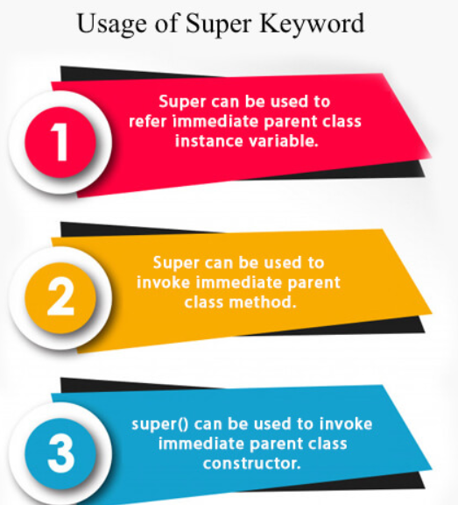
Super Keyword in Java
The super keyword in Java is a reference variable which is used to refer immediate parent class object.
Whenever you create the instance of subclass, an instance of parent class is created implicitly which is referred by super reference variable.

Slide 3
super is used to refer immediate parent class instance variable.
class Animal{
String color="white";
}
class Dog extends Animal{
String color="black";
void printColor(){
System.out.println(color);//prints color of Dog class
System.out.println(super.color);//prints color of Animal class
}
}
class TestSuper1{
public static void main(String args[]){
Dog d=new Dog();
d.printColor();
}}
black white

Slide 4
super can be used to invoke parent class method
The super keyword can also be used to invoke parent class method. It should be used if subclass contains the same method as parent class. In other words, it is used if method is overridden.
class Animal{
void eat(){System.out.println("eating...");}
}
class Dog extends Animal{
void eat(){System.out.println("eating bread...");}
void bark(){System.out.println("barking...");}
void work(){
super.eat();
bark();
}
}
class TestSuper2{
public static void main(String args[]){
Dog d=new Dog();
d.work();
}}
eating... barking...

Slide 5
super is used to invoke parent class constructor.
class Animal
{
Animal()
{System.out.println("animal is created");}
}
class Dog extends Animal{
Dog()
{
super();
System.out.println("dog is created");
}
}
class TestSuper3{
public static void main(String args[]){
Dog d=new Dog();
}}
animal is created dog is created

Slide 6
Why multiple inheritance is not supported in java?
To reduce the complexity and simplify the language, multiple inheritance is not supported in java.
class A{
void msg(){System.out.println("Hello");}
}
class B{
void msg(){System.out.println("Welcome");}
}
class C extends A,B{//suppose if it were
public static void main(String args[]){
C obj=new C();
obj.msg();//Now which msg() method would be invoked?
}
}

Slide 7
end of class2

